Slide 1

Field Development Plan & Frac Metric Automation
August 2025

Slide 2
Presentation Overview
Agenda
Field Development Planning (FDP) Workflow
FDP Algorithm
Completable and Drilling Length Auto-Calculation
UWI and Pad Auto-Naming
Dynamic FDP Dashboard
Automated Bulk Well Design
Example Applications
Realtime Frac Dashboard
Post-stage Automated Pressure Analysis
Frac Hit Analysis
Conclusion

Slide 3
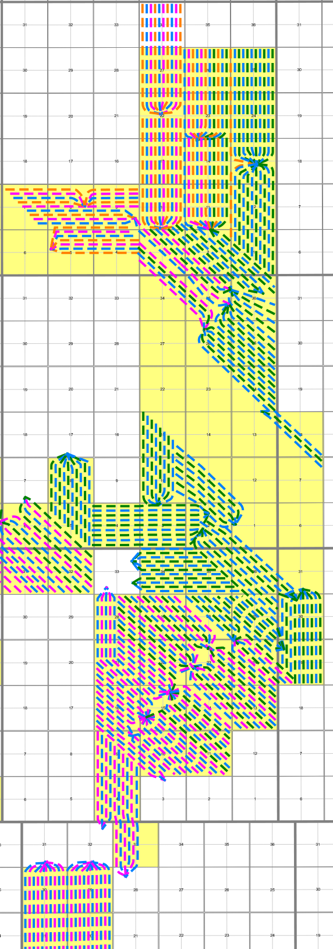
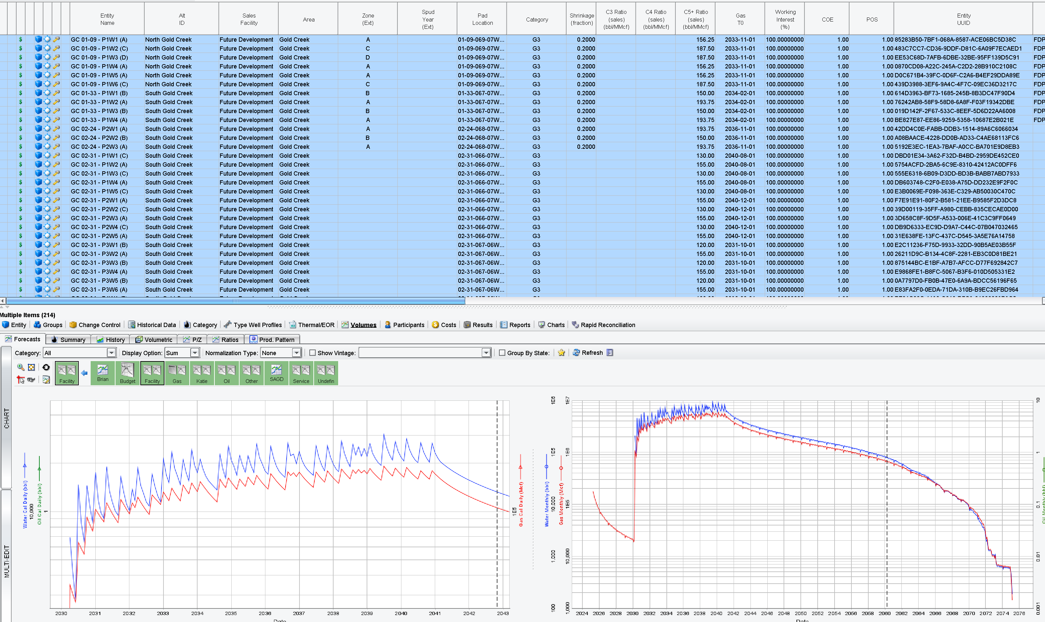
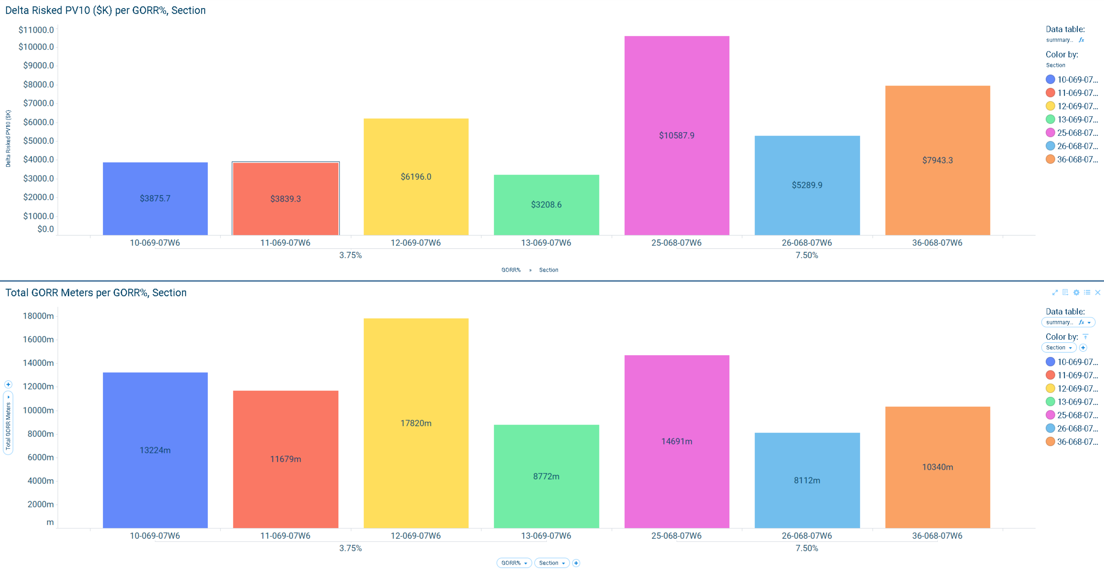
FDP Workflow
Field Development Plan Automation
Converting Raw Field Development Plan Shapefile’s into fully designed Future Wells.
Input:
FDP Shapefile
Input
Output
Old
New
FDP Shapefile
250+ Planned Wells
Future wells fully created and designed in Mosaic.
Manually Assign each well it’s UWI & Pad Location
FDP Automation Algorithm
Measure well lengths (drilling and completable)
Add Completion Parameters
Add Type Curves + CGR/WGR
Dynamic Spotfire Dashboard
Conclusion: New FDP Automation workflow increases planning accuracy, reduces/removes redundant tasks and creates off the shelf entities for Budget and Long-Range Planning analyses
Add Capital Costs
Output: Mosaic Entities Ready for Economic Evaluation

Slide 4
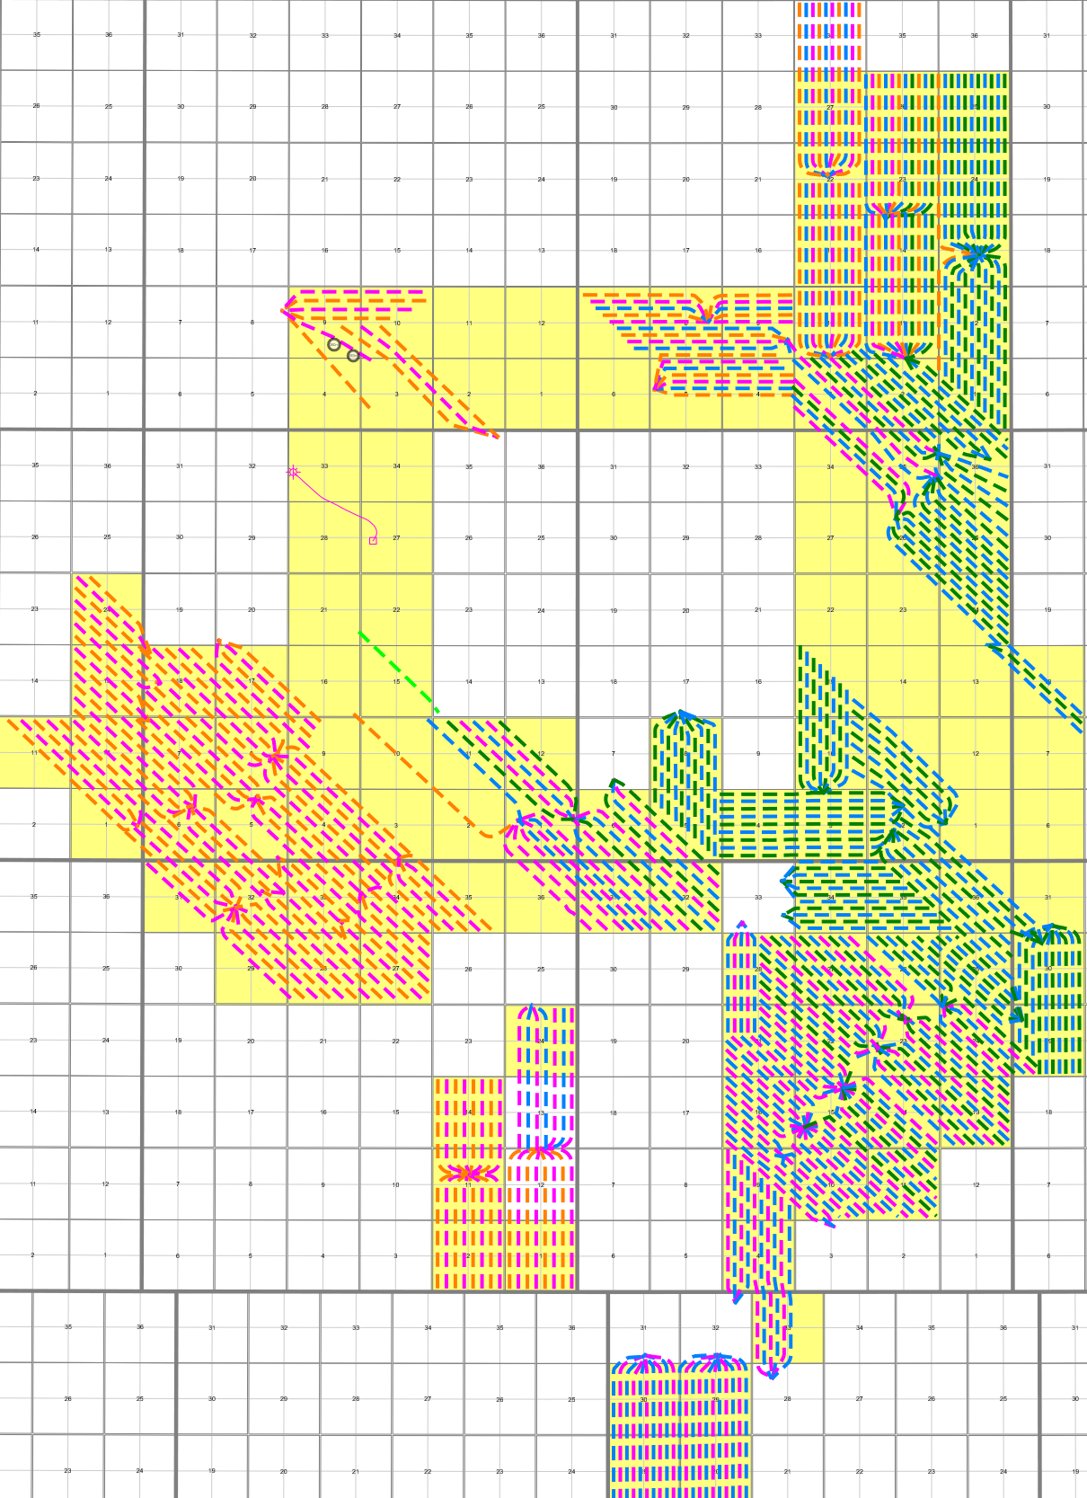
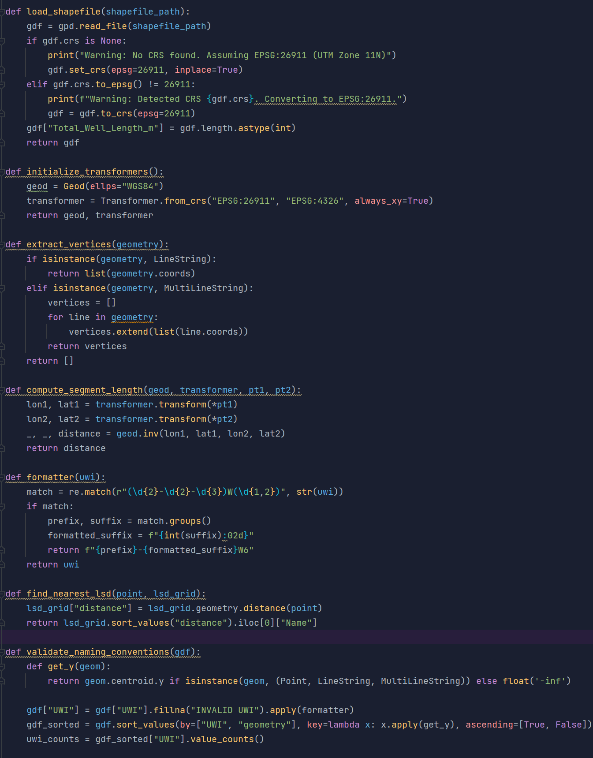
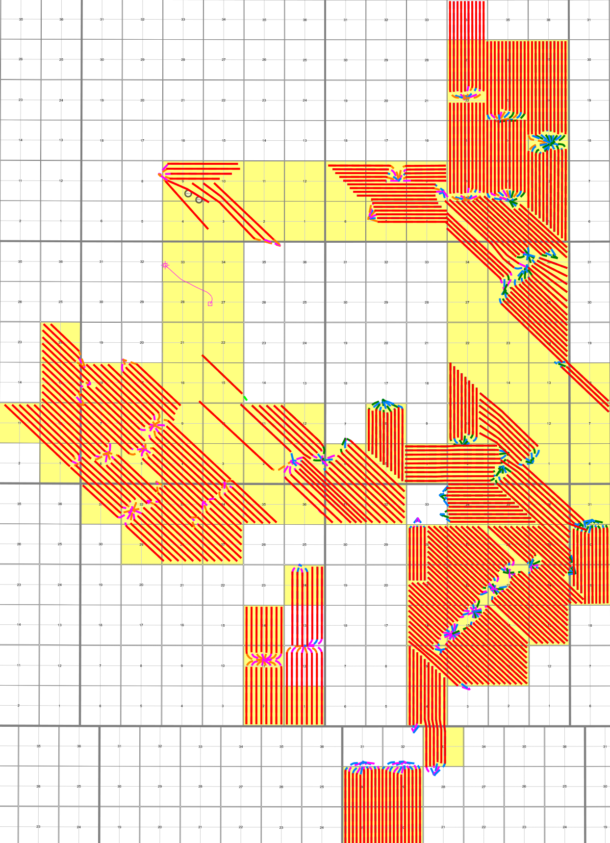
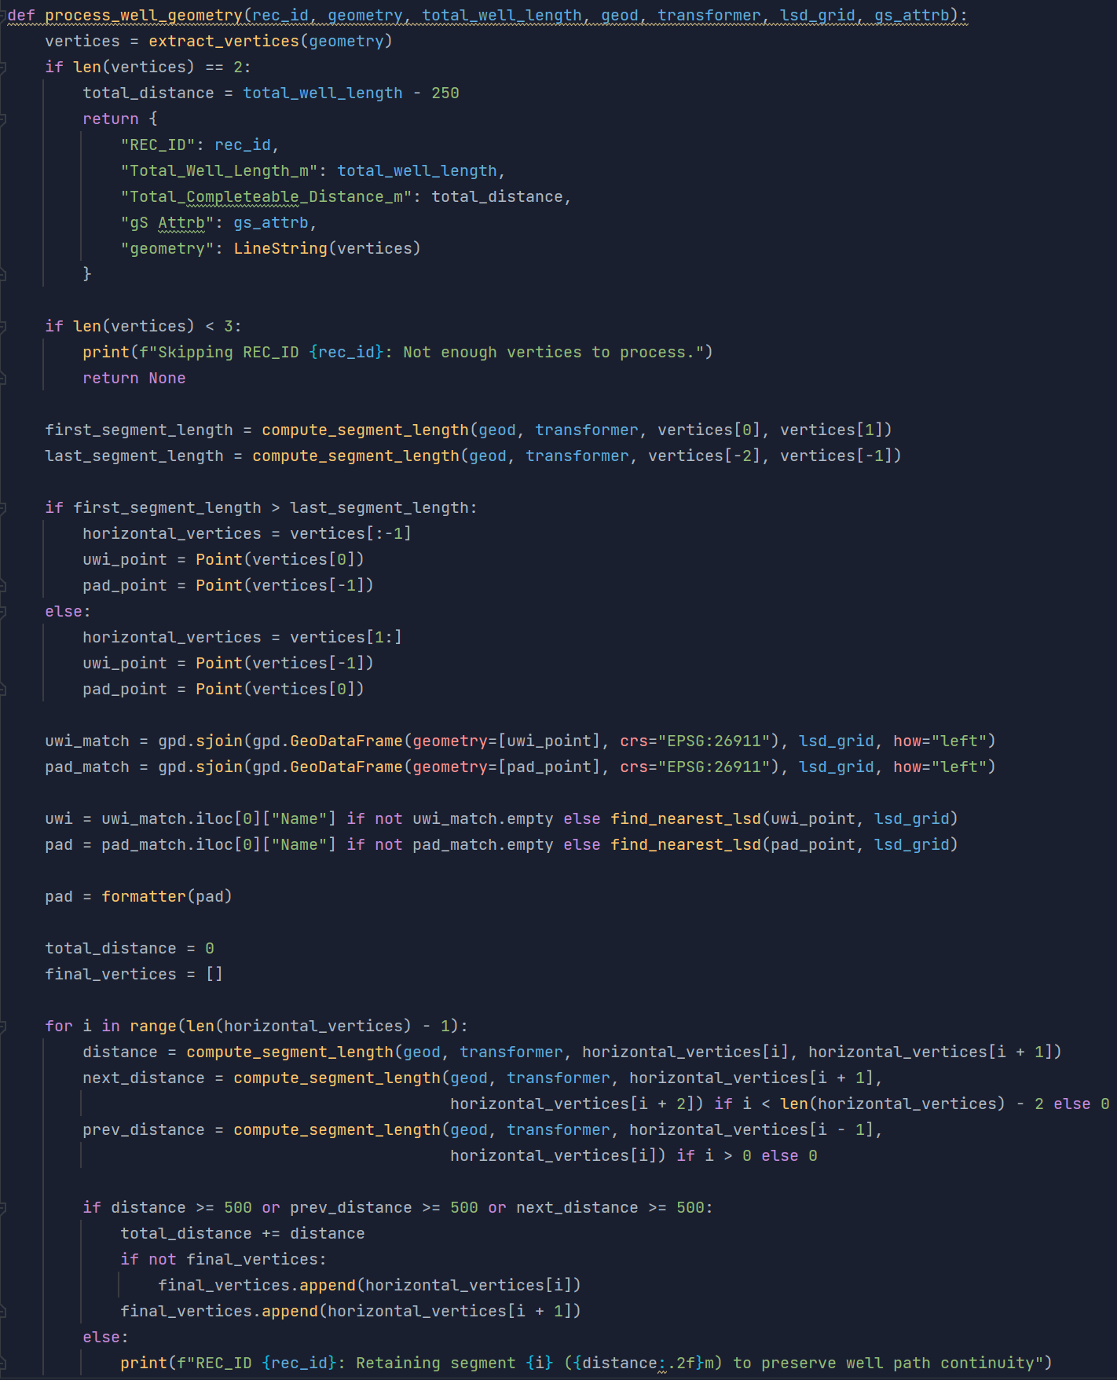
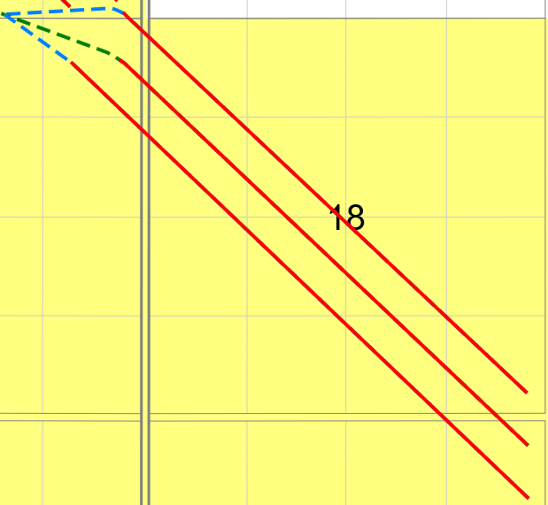
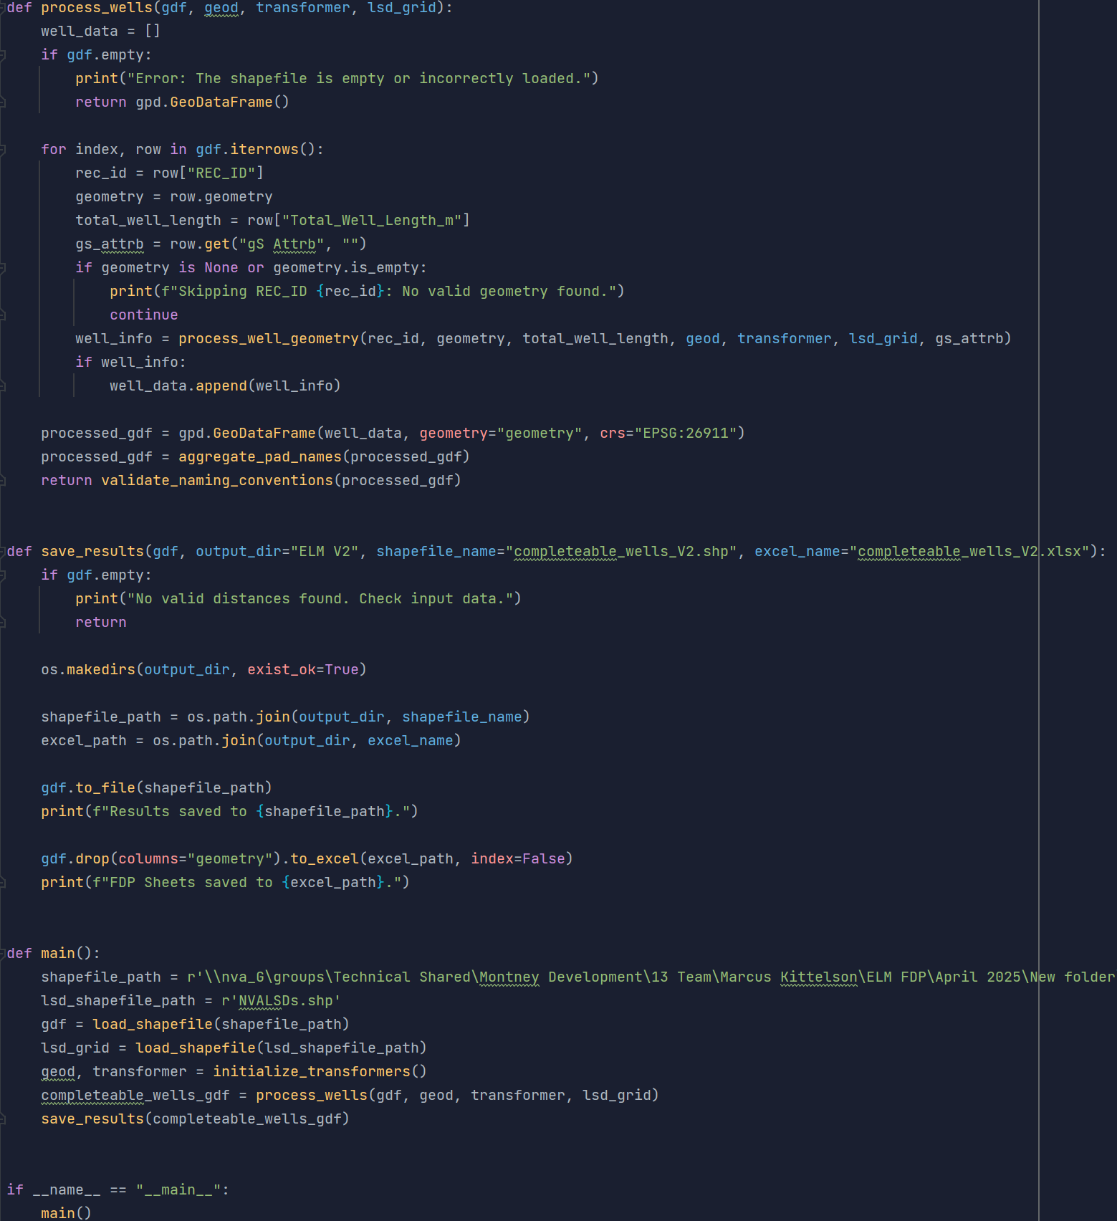

FDP Algorithm: Completable Length Calculation
FDP Shapefile
Calculation Code
Auto-name Code
Dynamic Dashboard
Ready for Evaluation
1 – FDP Algorithm 1st Component
Code calculates the completable length for all wells in the raw shapefile in a single pass, identifying precise locations of the toe and heel utilizing geometric math. Removing the time-consuming measuring process.
Raw FDP Shapefile
Python Calculation Algorithm
Completable Length Shapefile & Excel Sheet
Input
Output
Red overlay is completable
Accurate drill/completable lengths help obtain more accurate budget inputs for five year outlook
Conclusion: Algorithm increases precision in planning by providing well-specific measurements for an entire field, in a matter of a seconds.
Code can compute ~25 wells/second.

Slide 5
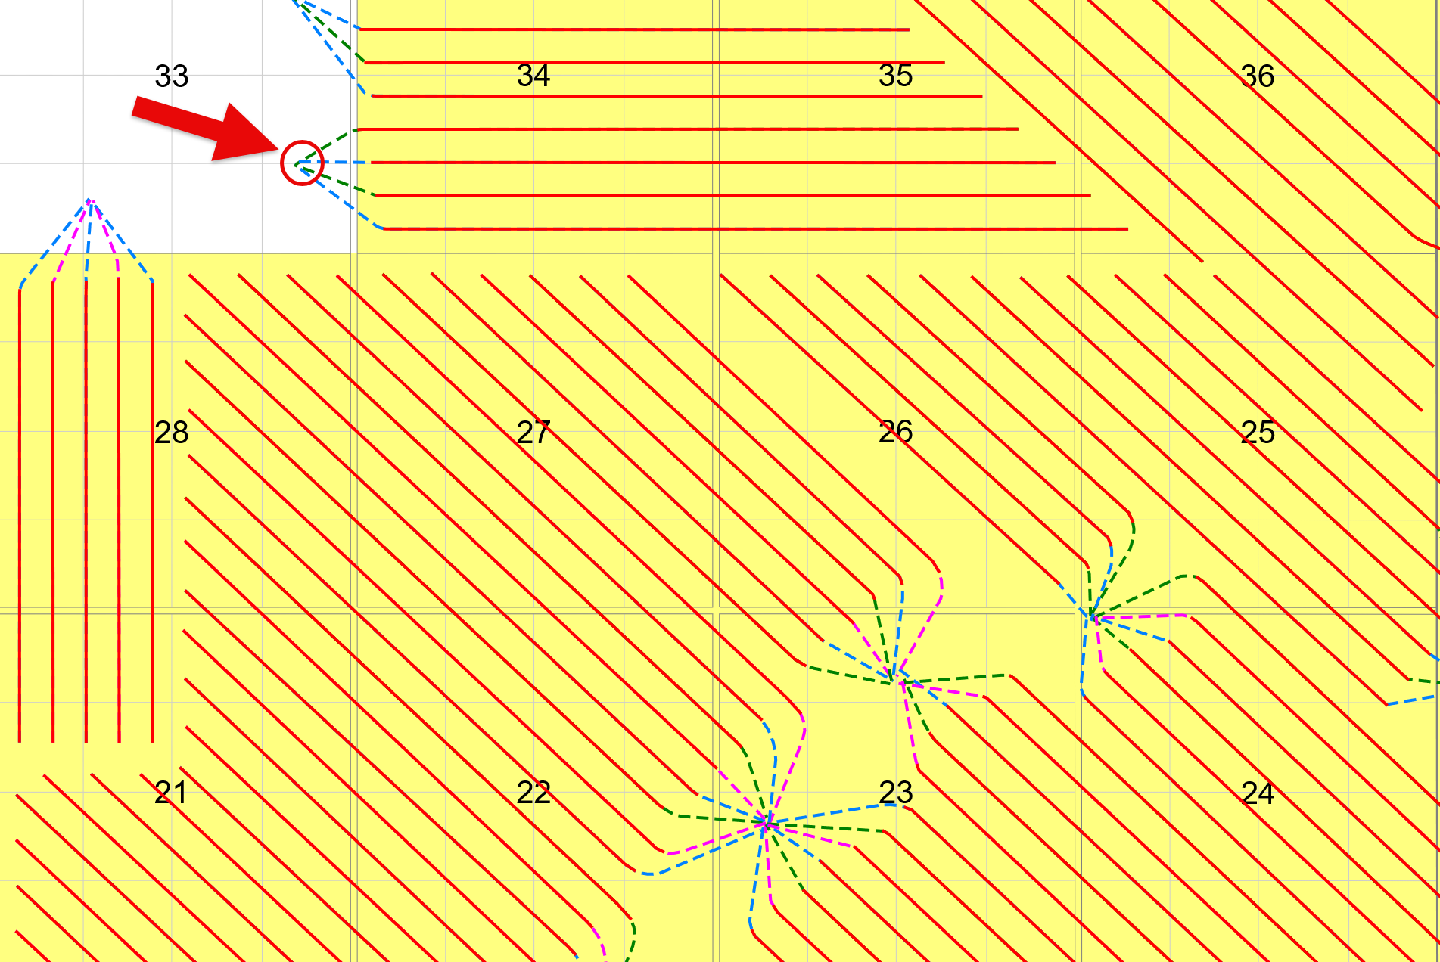
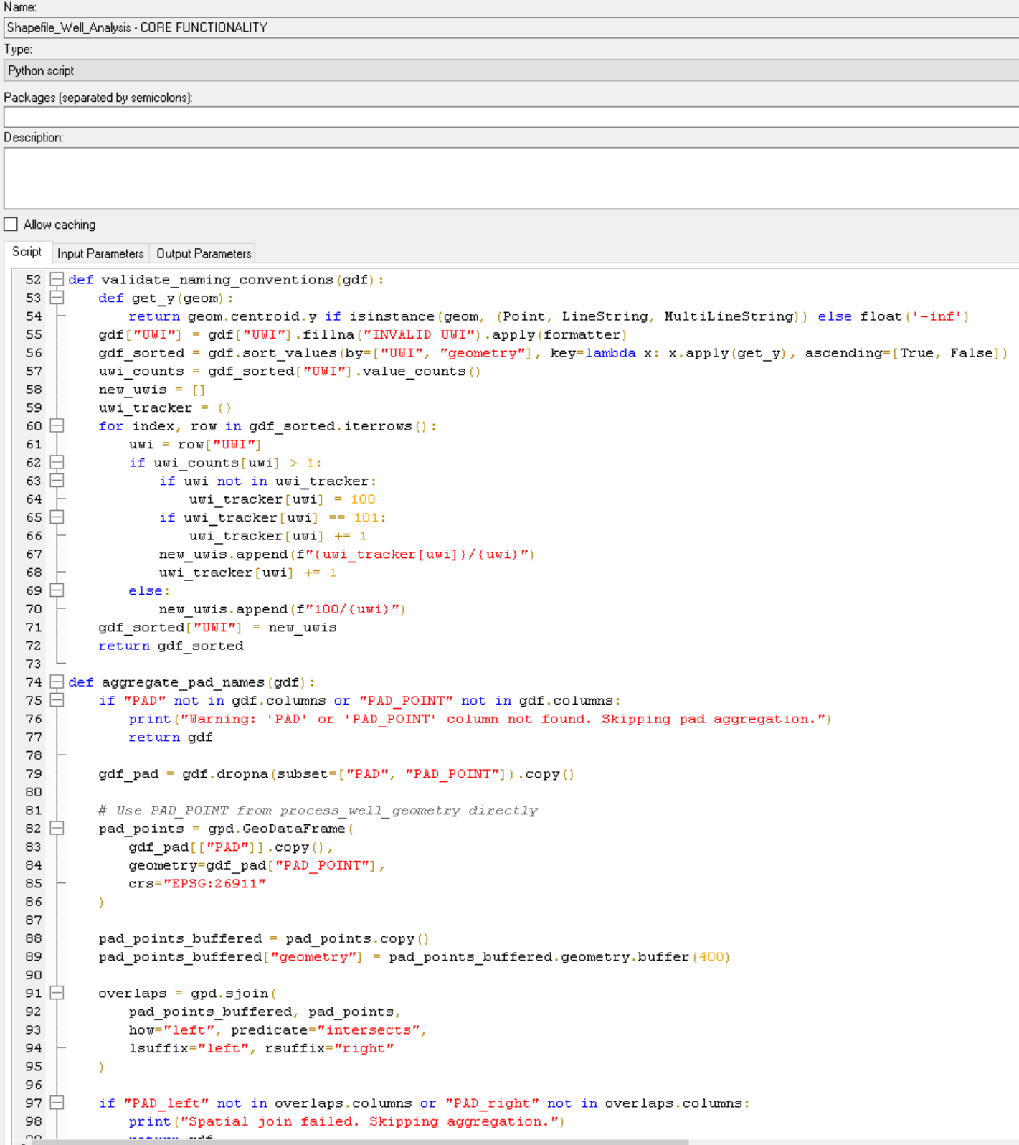
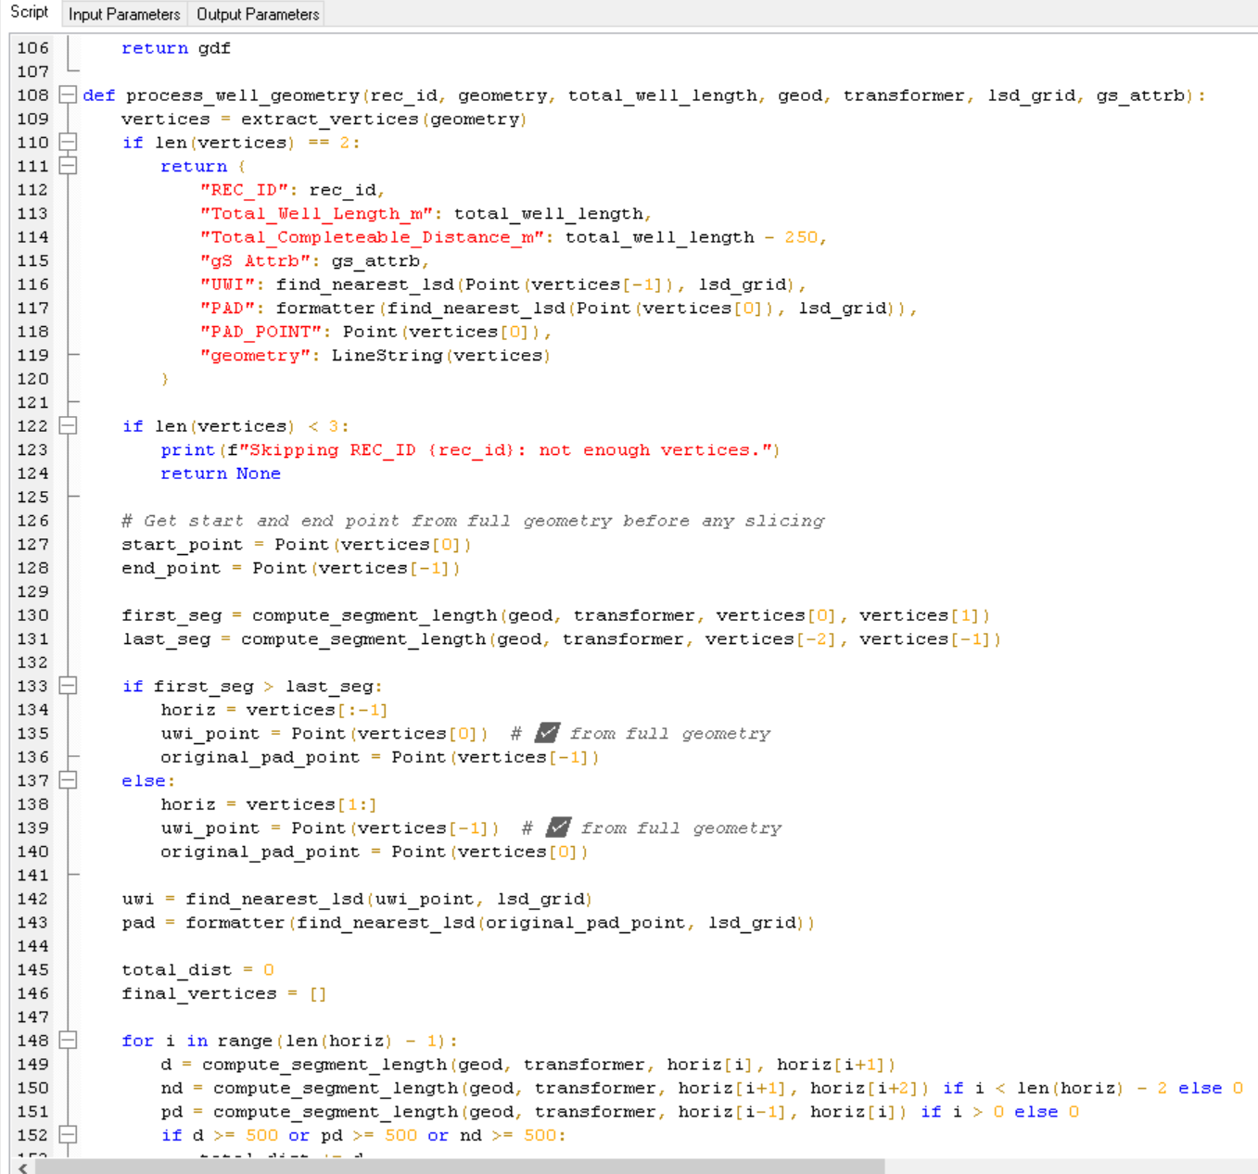
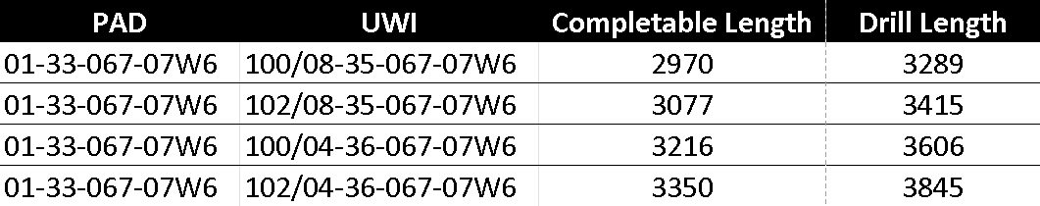

FDP Algorithm: Auto-assignment of UWI & Pad Location
FDP Shapefile
Calculation Code
Auto-name Code
Dynamic Dashboard
Ready for Evaluation
2 - FDP Algorithm 1st Component
After the algorithm identifies the toe point and location of the pad, the code maps each well to their respective sections – removing the repetitive task of naming every well.
FDP Shapefile
Python Auto-name Algorithm
Final Algorithm Sheet
(All values below are automated)
LSD Section Shapefile
Conclusion: Algorithm reduces time spent on well location assignment by ~99%.

Slide 6
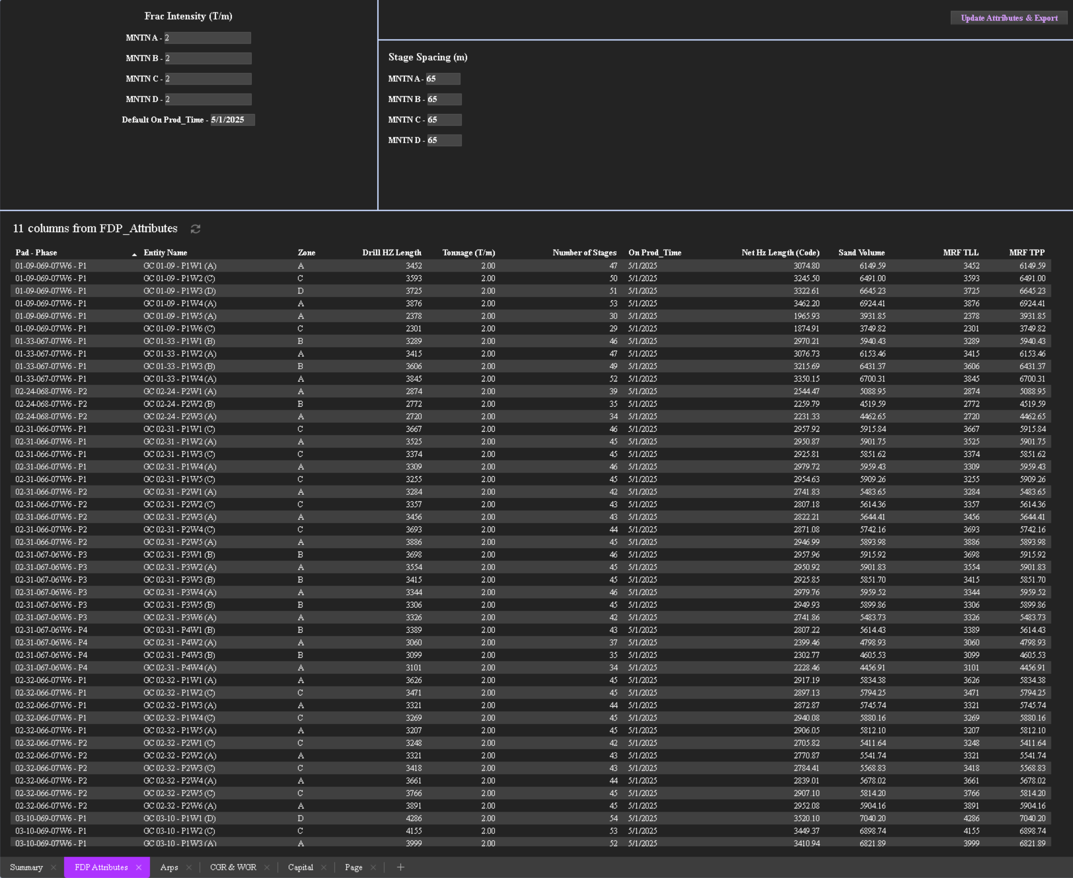
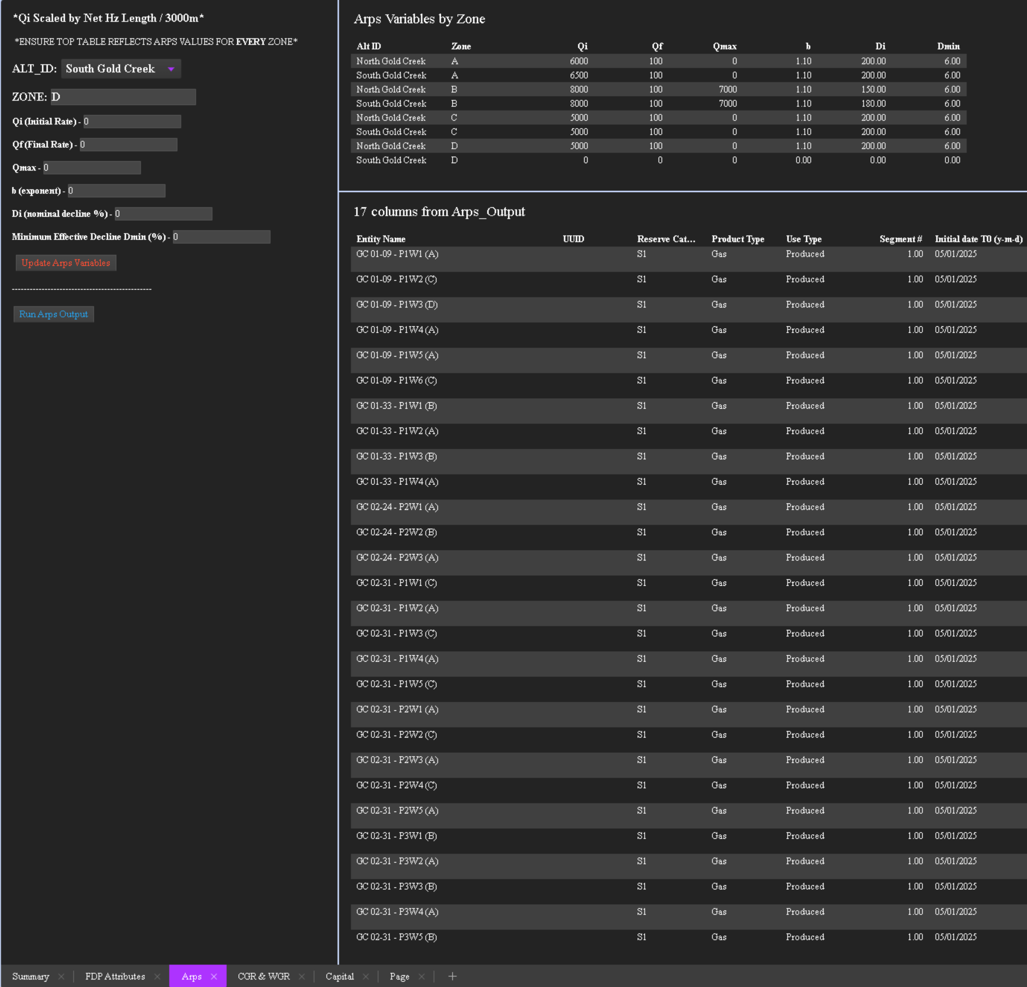
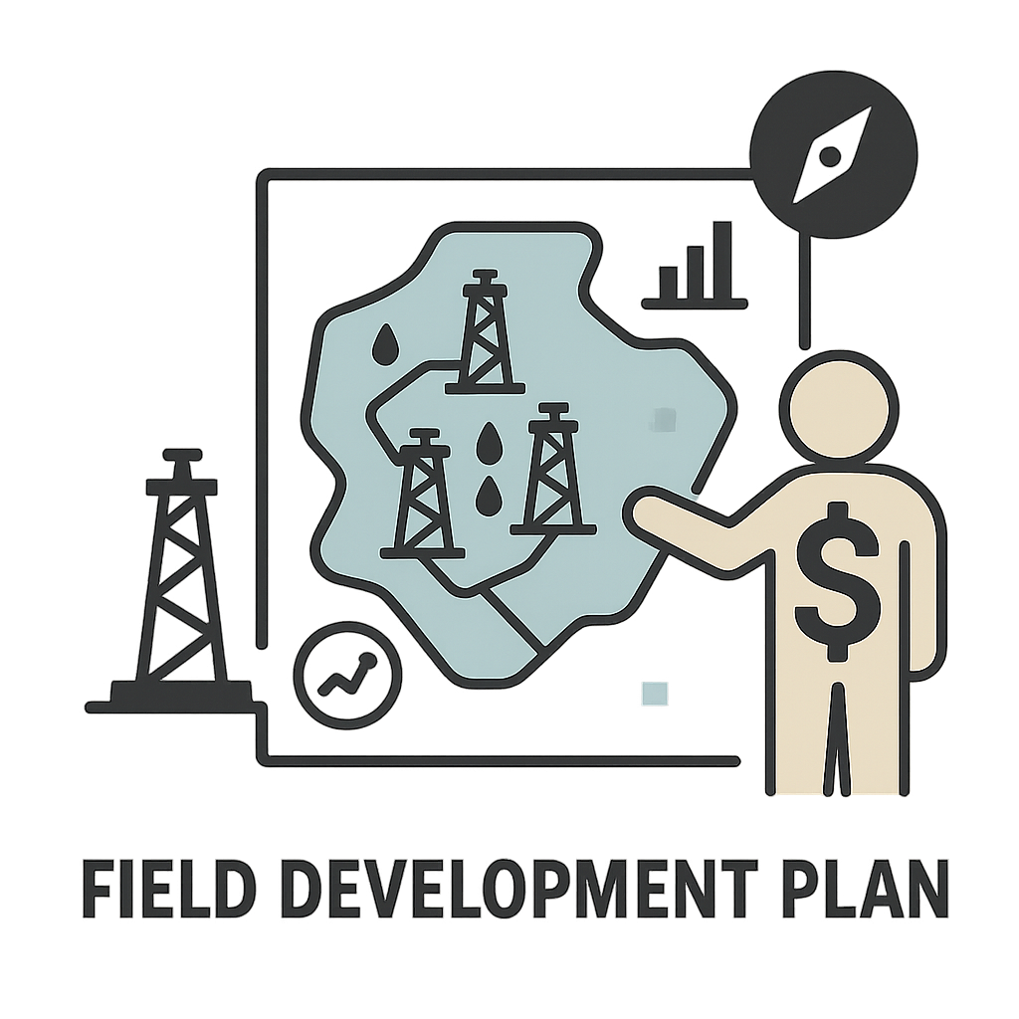
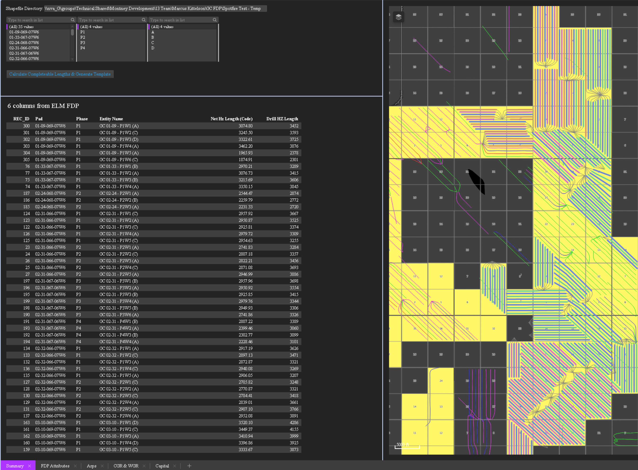
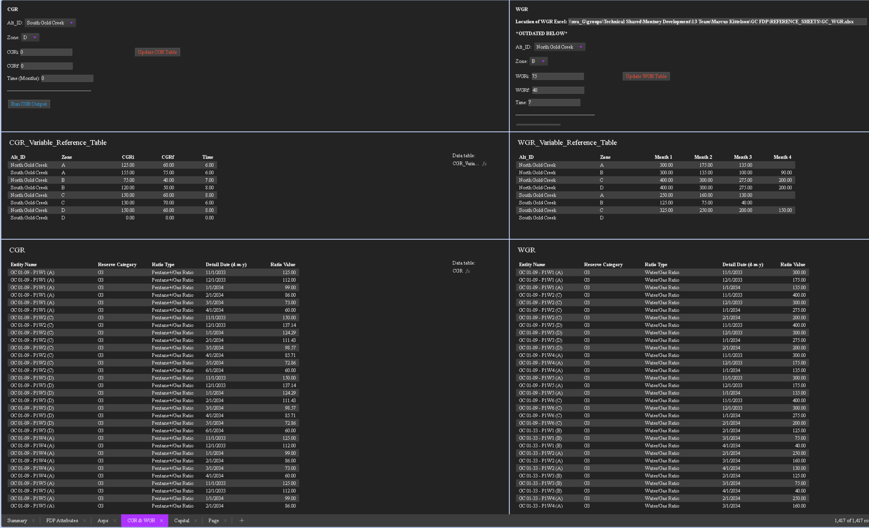
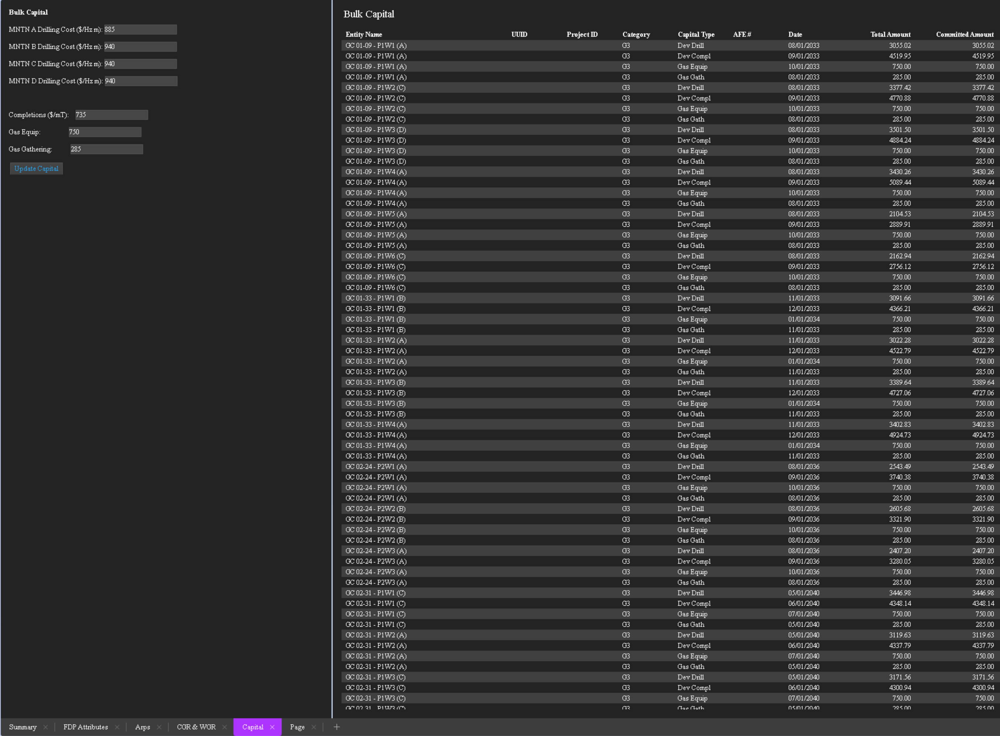
FDP Dynamic Dashboard
FDP Shapefile
Calculation Code
Auto-name Code
Dynamic Dashboard
Ready for Evaluation
Dynamic Spotfire dashboard houses many Python Scripts, used to specify well parameters in bulk - has fields to enter all parameters and the code handles the rest. One-click exports into evaluation software Mosaic (economics and reserves evaluation platform).
Completions Tab
Calculates total sand volume (used in royalties), stage count, etc.
Type Curves Tab
FDP Dashboard
Generates volume forecast parameters by sub-area, scales curves by completable length.
CGR & WGR Tab
Creates a month-by-month ratio forecast.
Capital Costs Tab
Conclusion: The dashboard automates processing and uses the auto-calculated drilling and completed lengths - key well parameters - reducing time while increasing field development plan accuracy.
Calculates drilling cost (by zone), and completions cost (based on sand calculated in the completions tab). Updates Gas Equip and Gathering Cost.

Slide 7
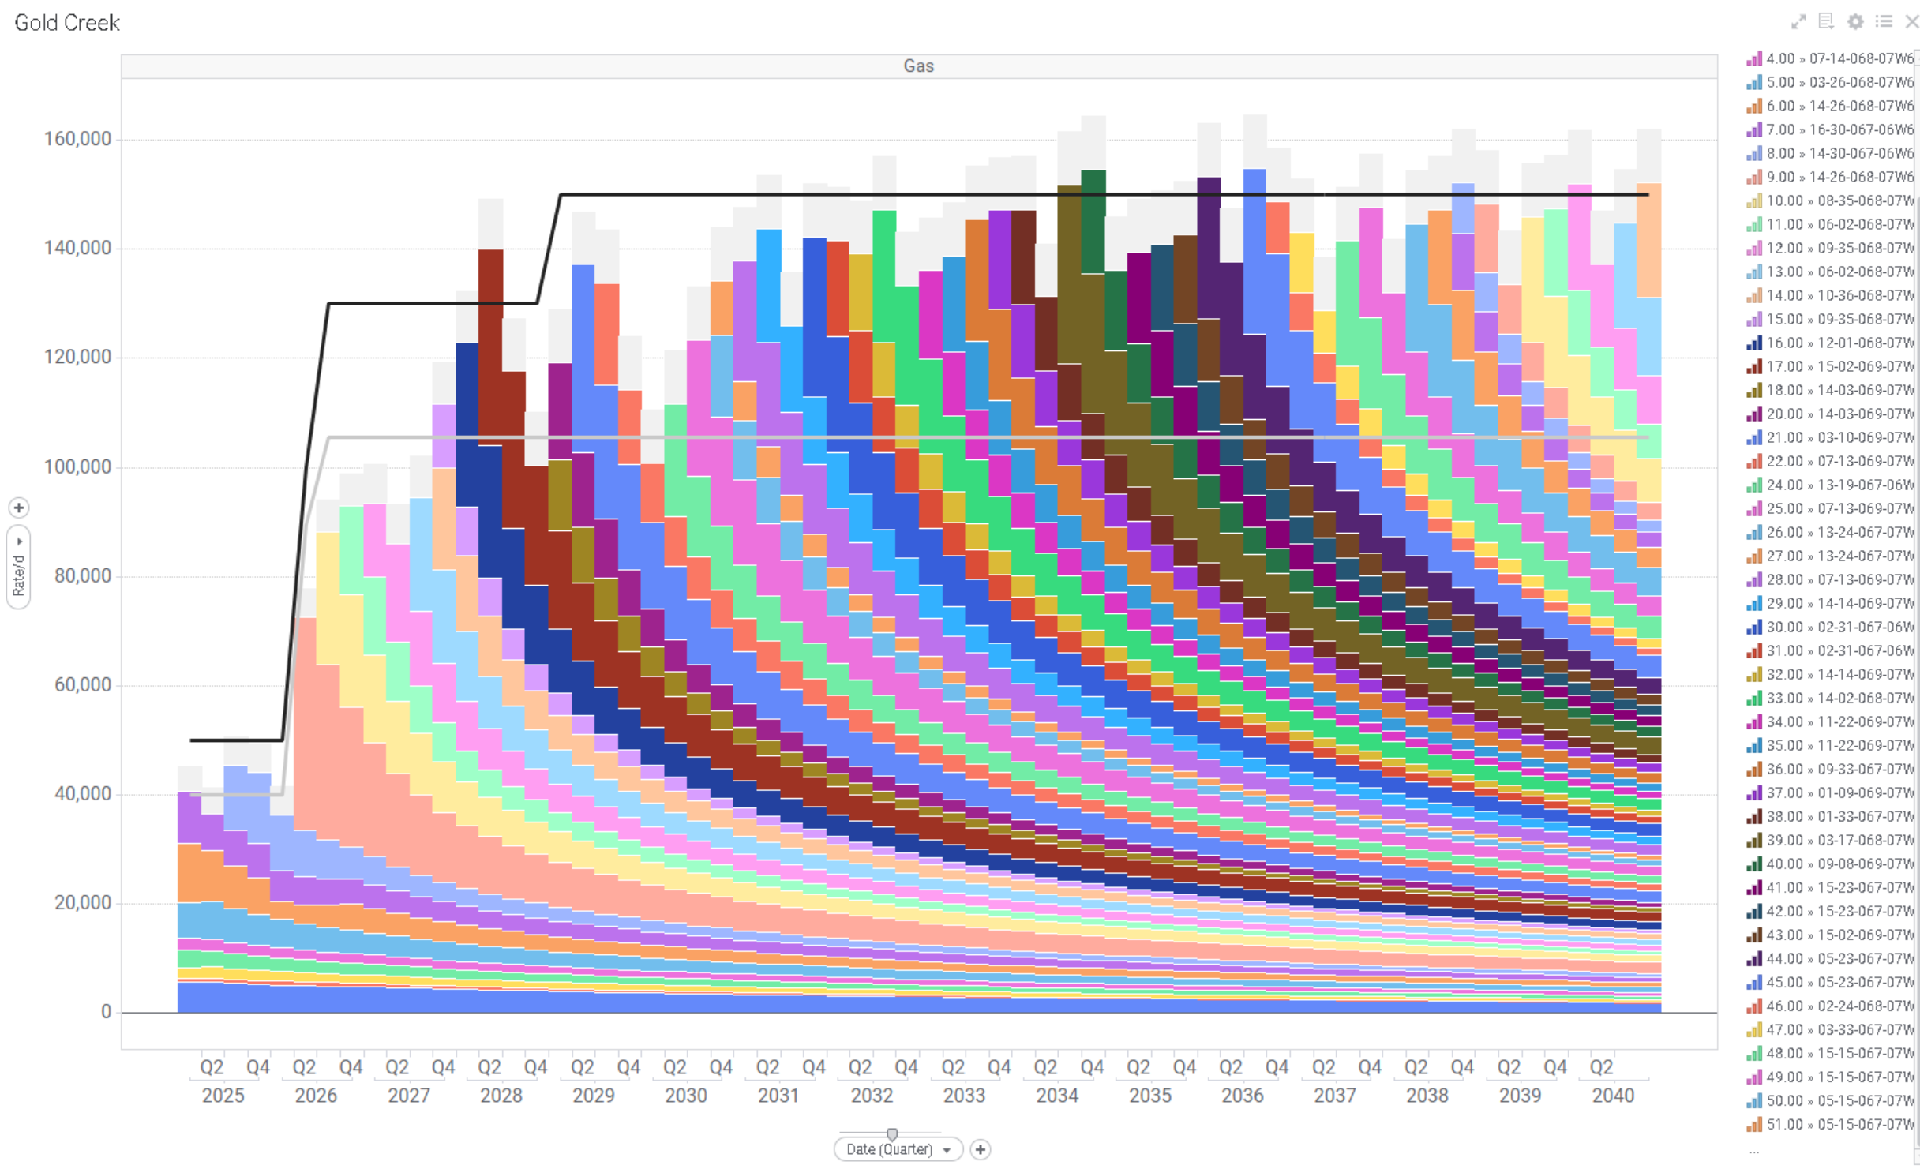
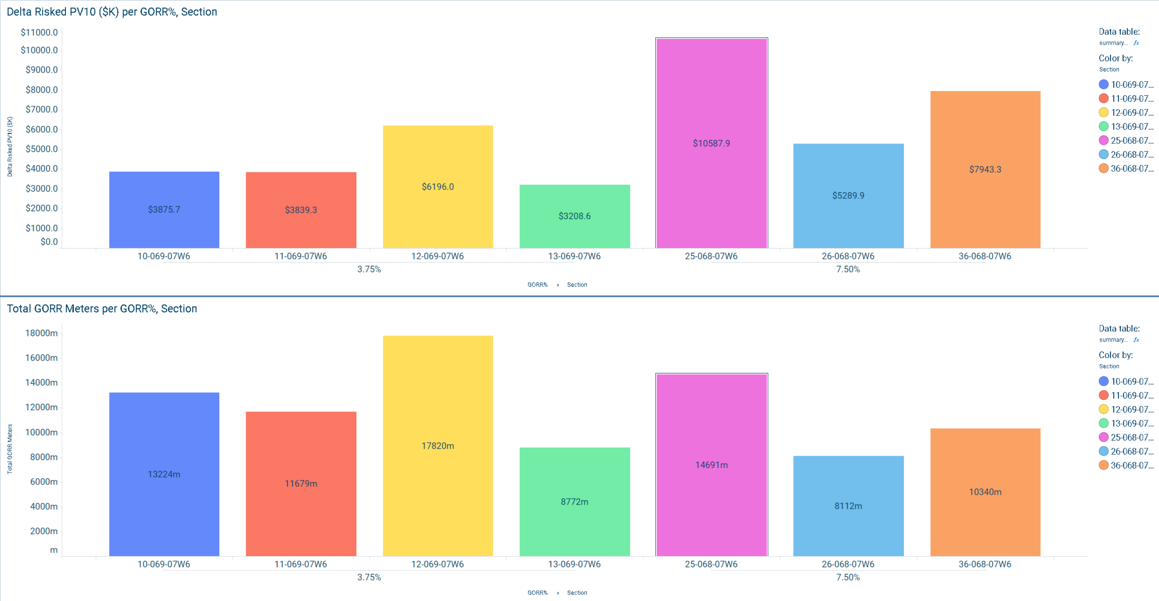
FDP Workflow – Applications
FDP Shapefile
Calculation Code
Auto-name Code
Dynamic Dashboard
Ready for Evaluation
Field Development Planning
Gold Creek Infrastructure Planning
GORR Evaluation – Risked PV10
Workflow applied to assess the GC FDP for long-range volumetric planning through 2040, providing volume recommendations for hydraulic modeling. In collaboration with Aaron Shaw to deliver an accurate evaluation of the recommended gas-gathering system.
The new workflow enabled a precise evaluation of the Gold Creek sections, quantifying the change in Risked PV10 attributable to each section’s respective GORR. This was achieved using exact linear meterage measurements, ensuring accuracy in assessing the economic impact at a granular level.
Conclusion: The new FDP workflow delivers faster, more precise volumetric and economic analyses.

Slide 8
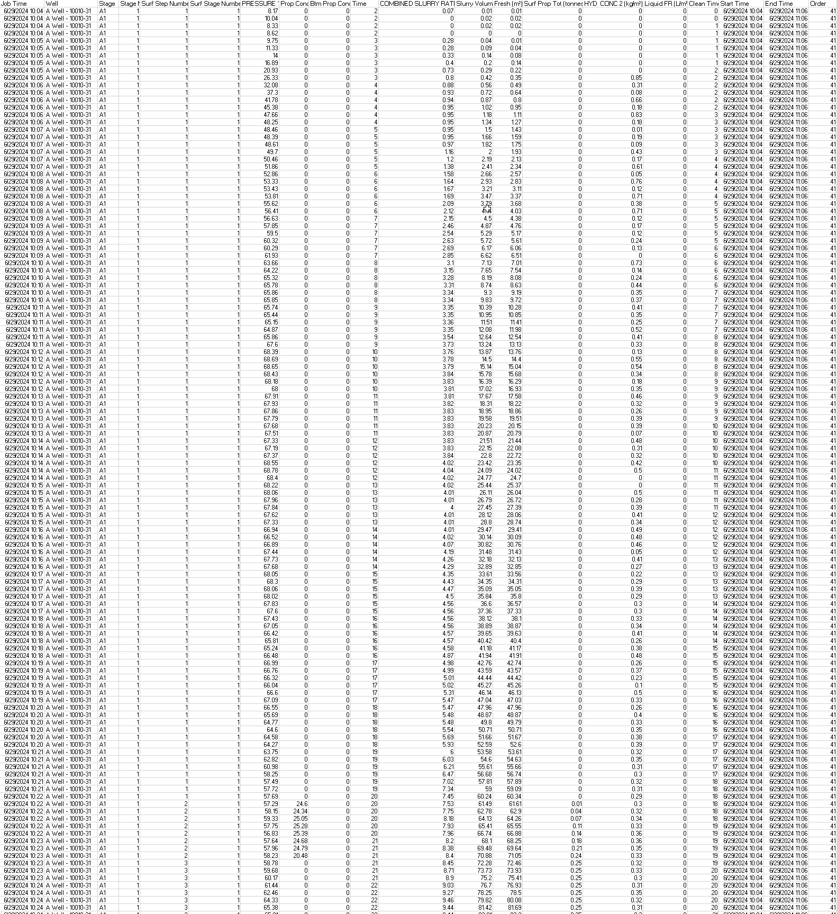
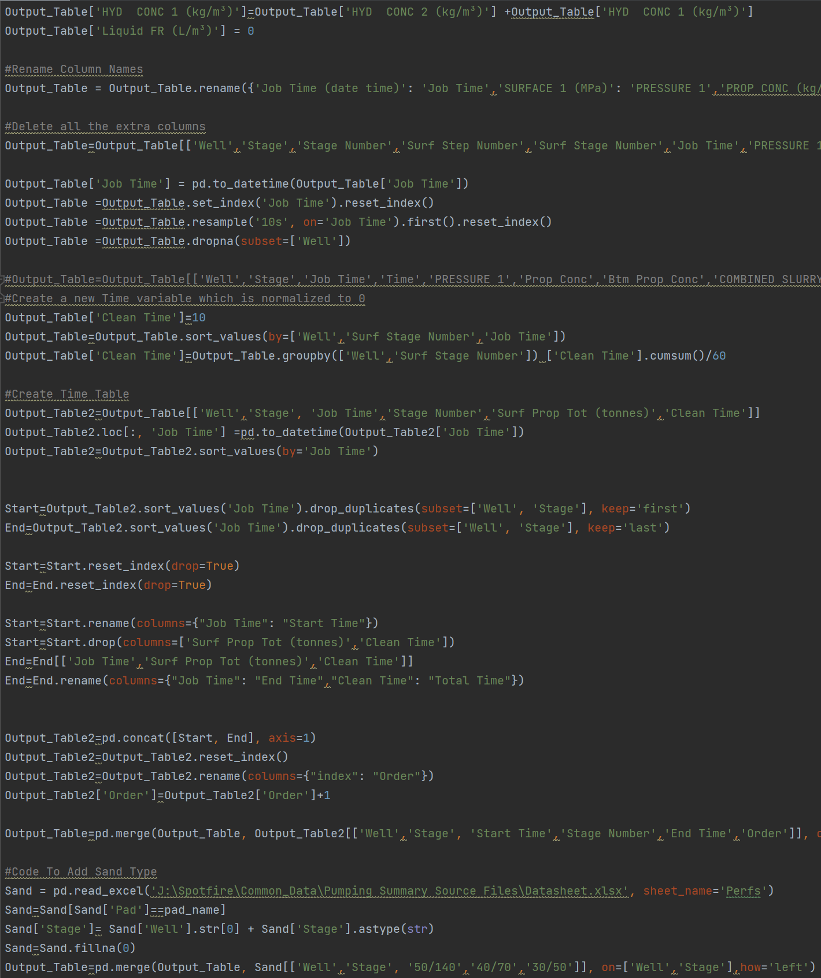
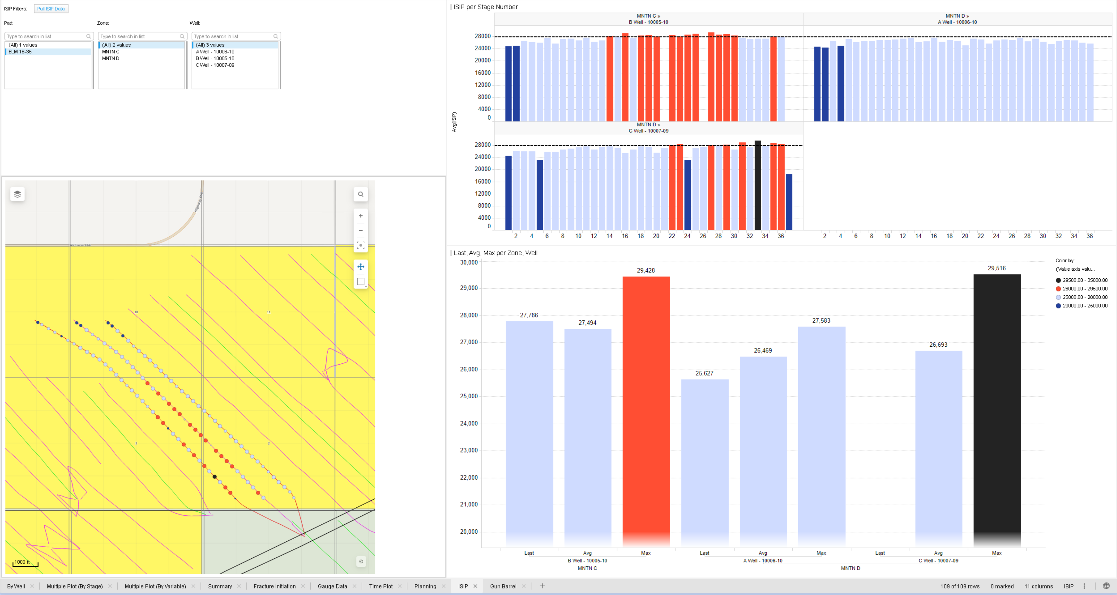
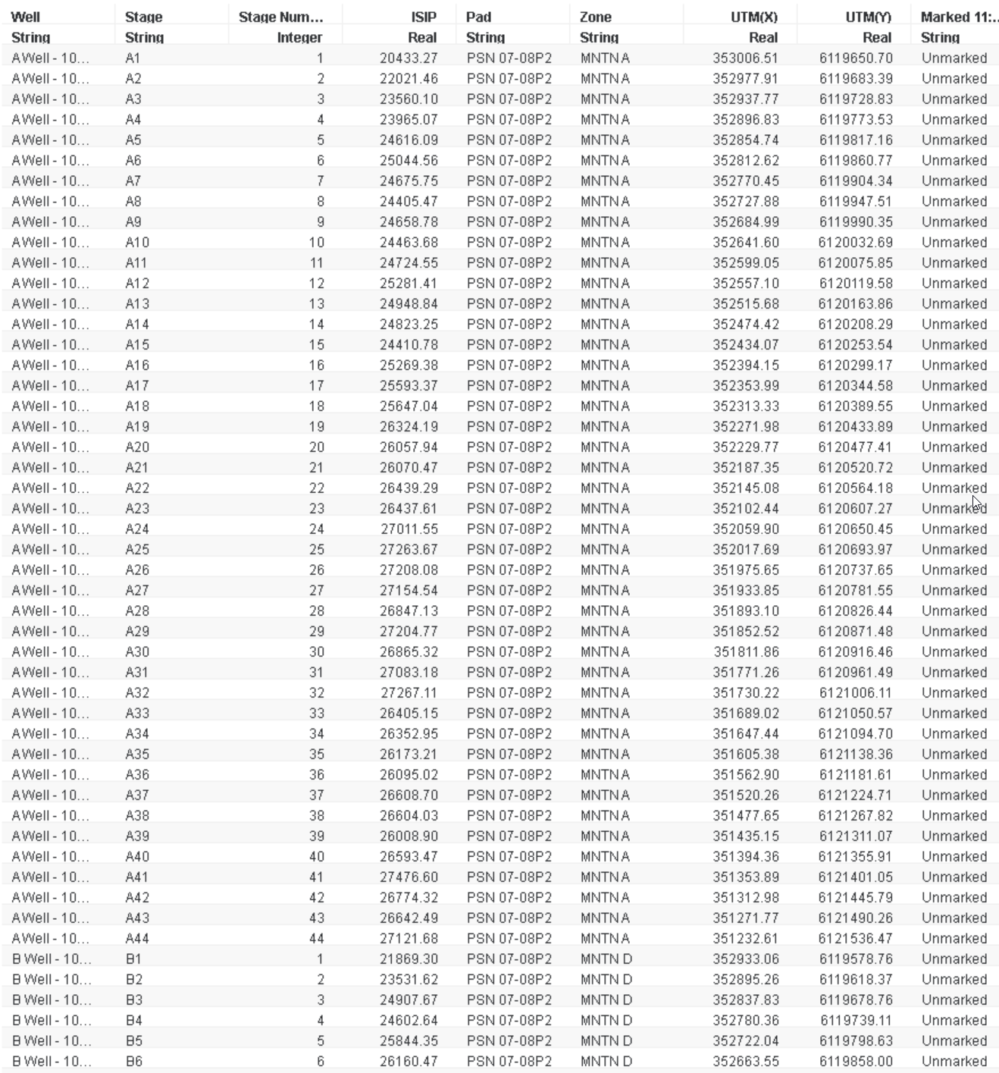
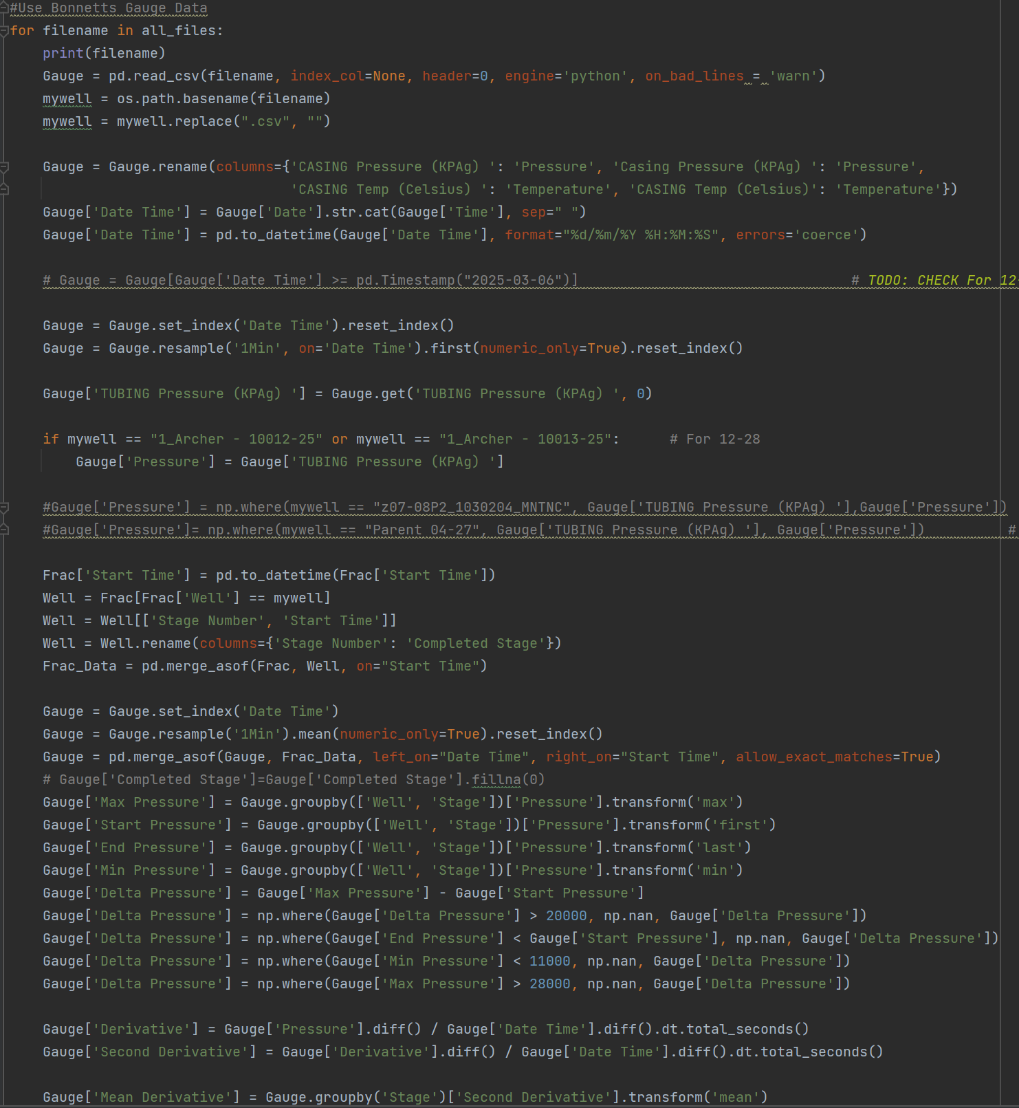
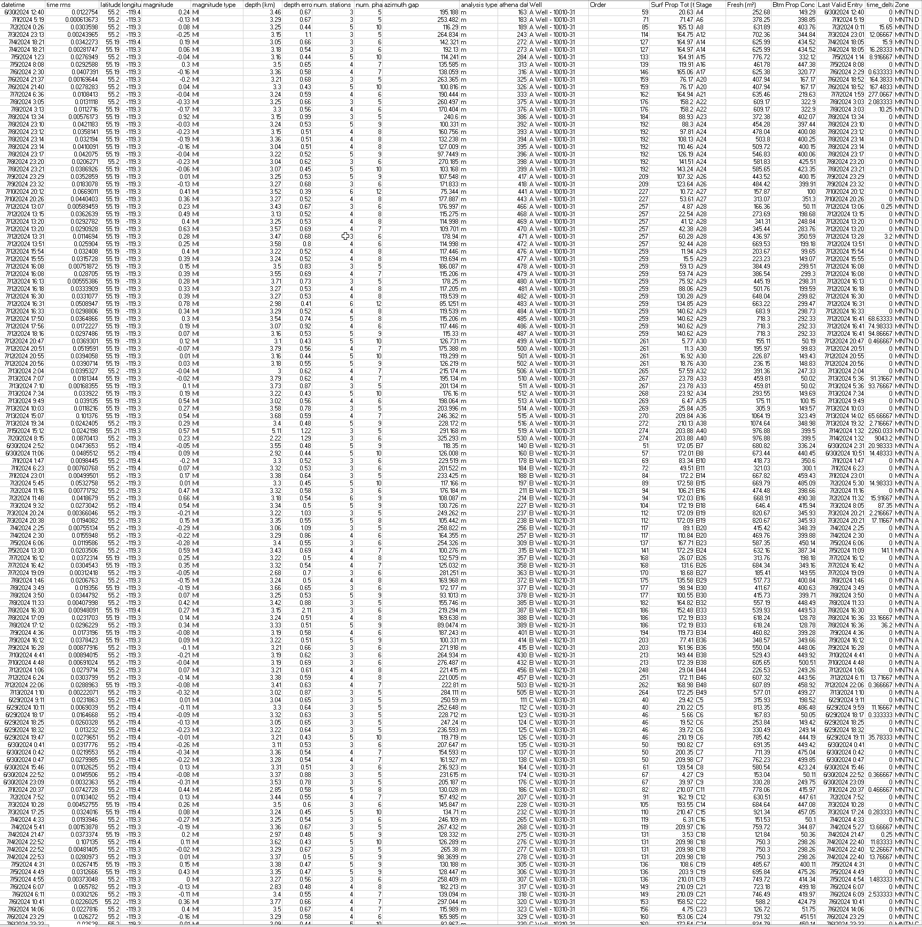
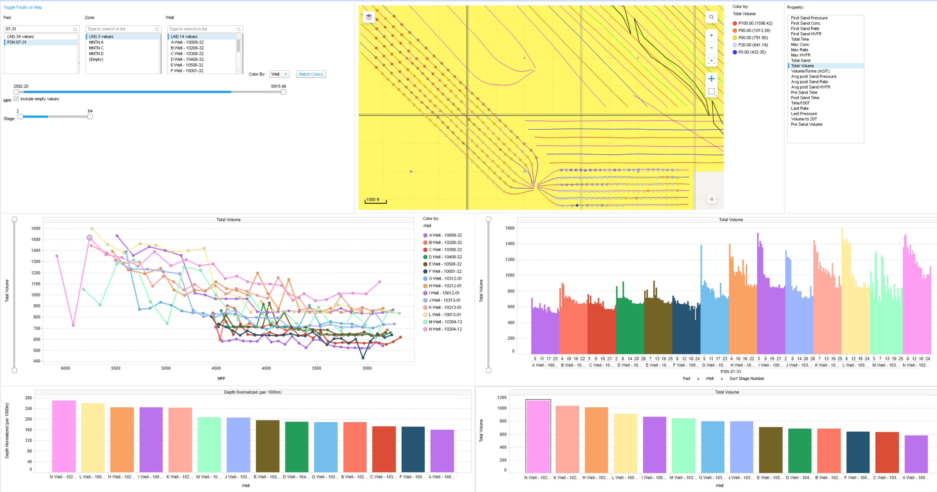
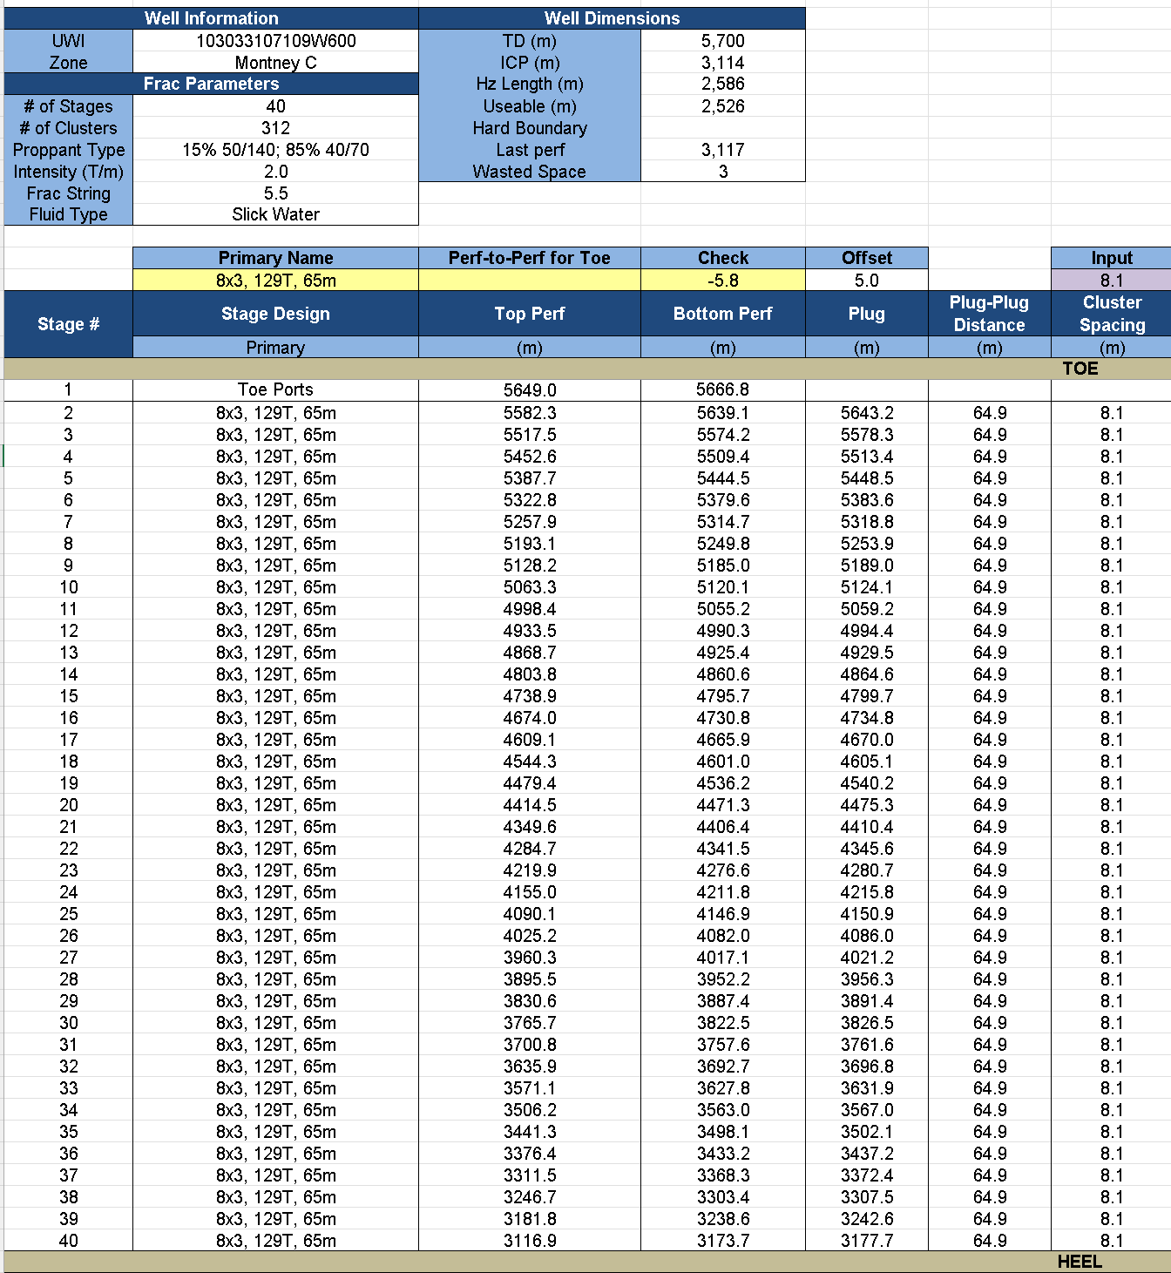
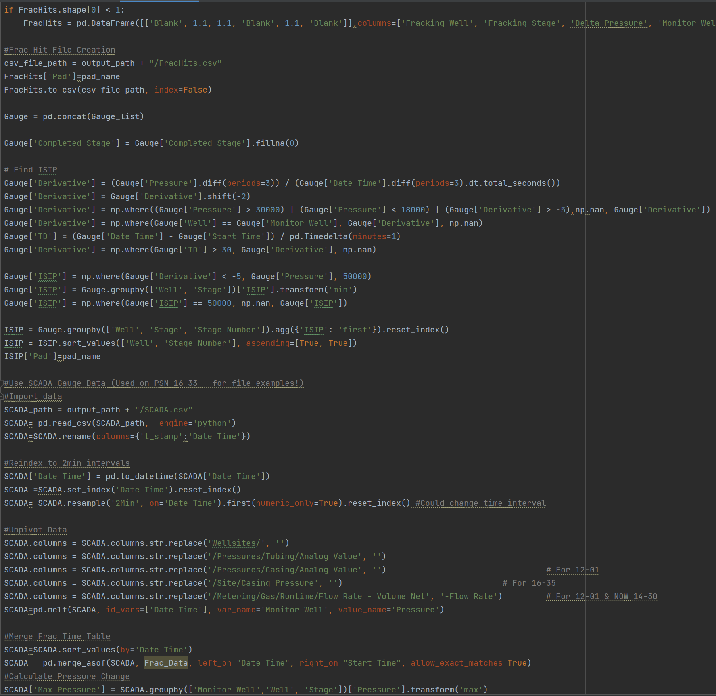
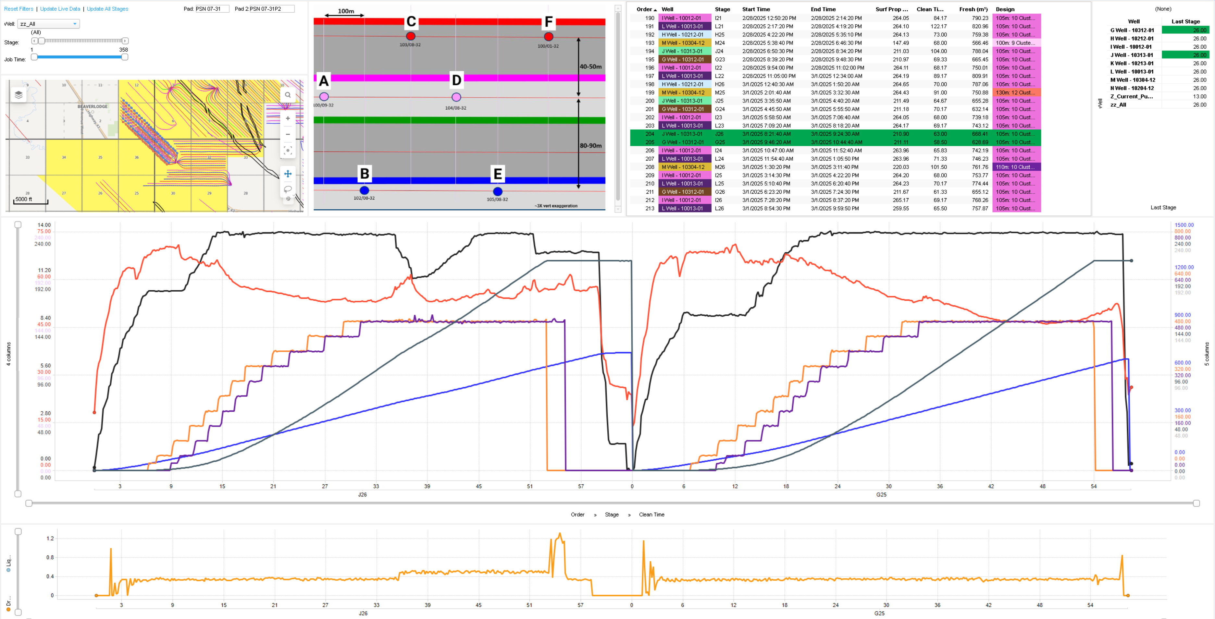
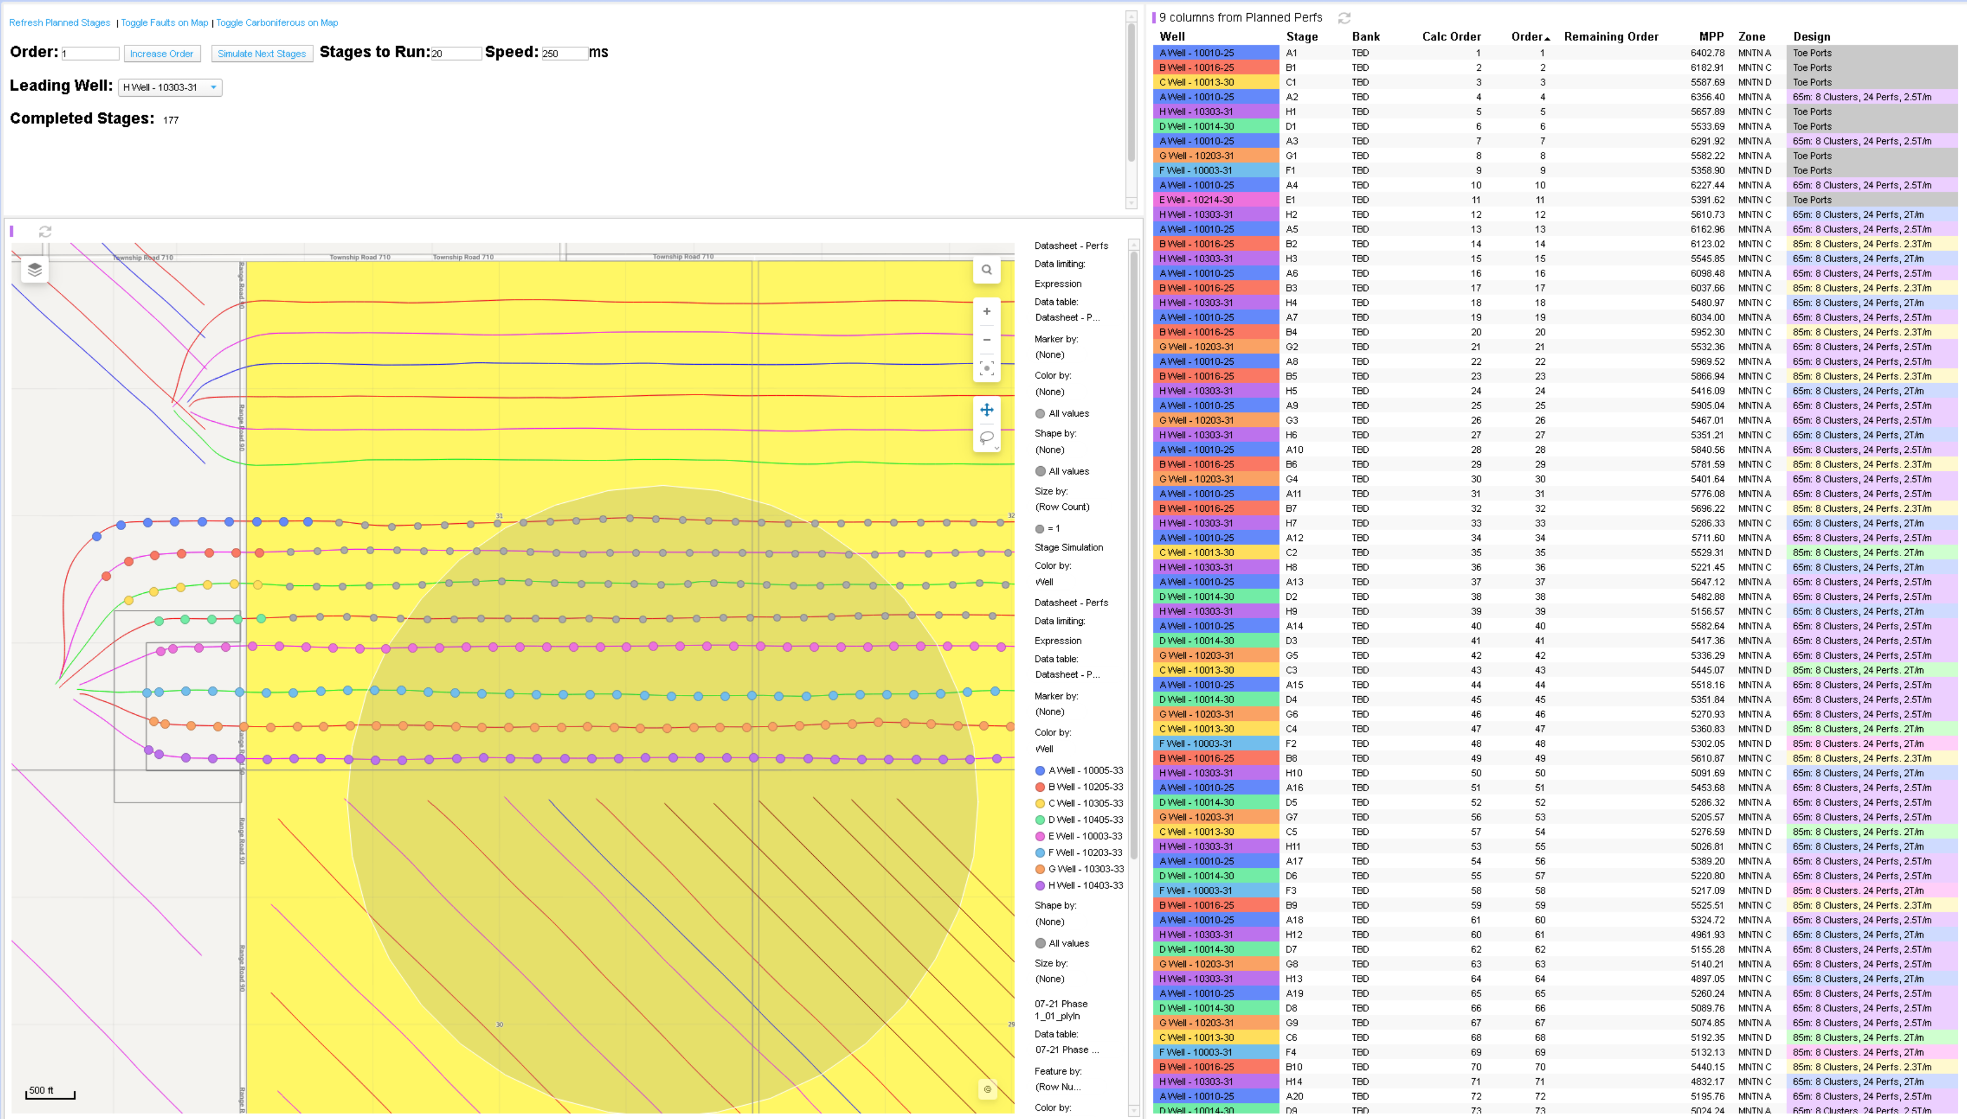
Frac Spotfire Dashboard
Frac Dashboards integrated with Python Code allow for efficient real-time monitoring to create data-driven improvements during operations. Used by team daily during operations in morning call.
Raw Pumping Data
Auto-run Python Scripts
Realtime Spotfire Visualizations
1,000,000+ Datapoints/week
Frac Dashboards Created:
PSN 16-33, ELM 12-05, BIL 10-29, PSN 07-31, ELM 12-01, GC 14-30, ELM 16-35, PSN 12-28 and PSS 02-36P2
Frac Planning and Sequencing created alongside.

Slide 9
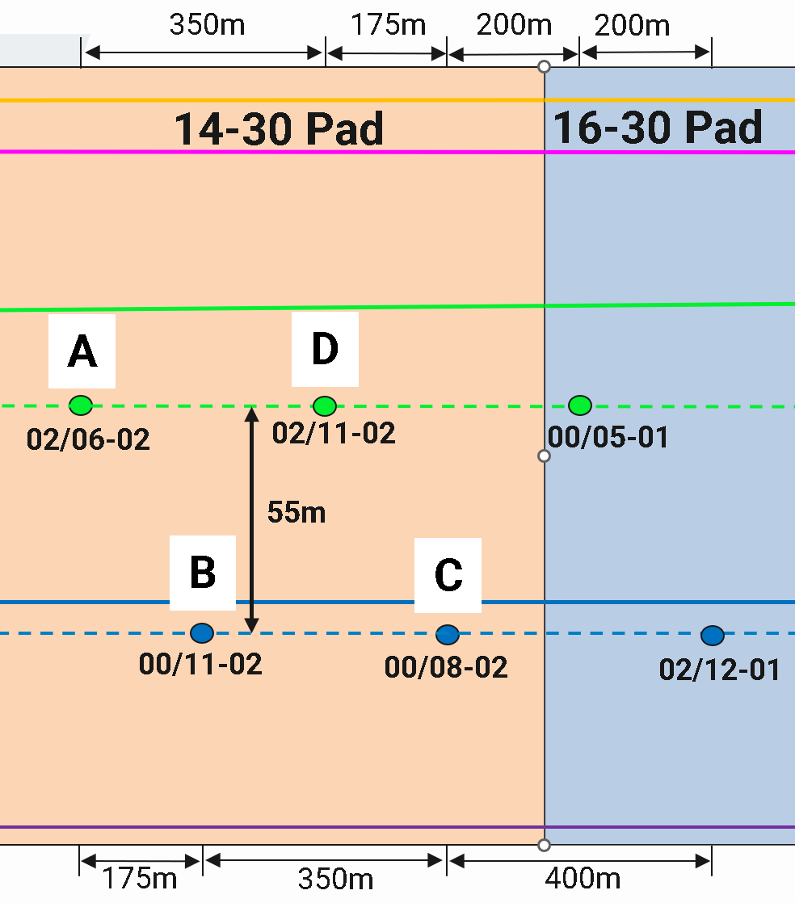
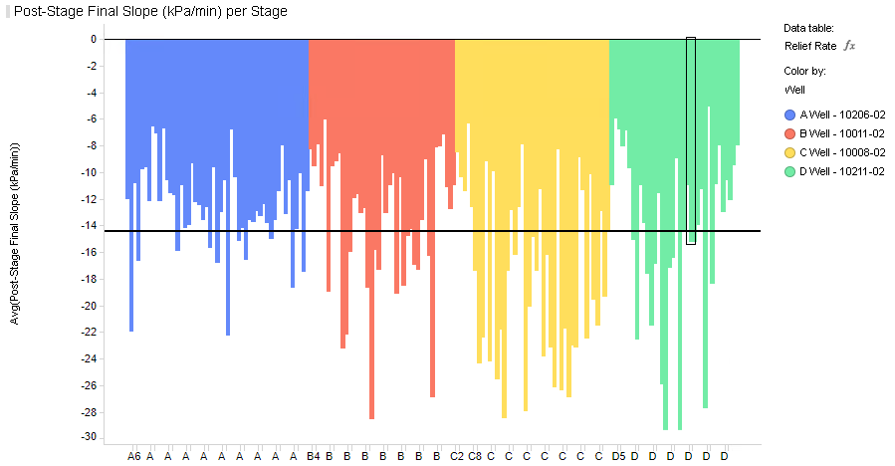
Post-Stage Pressure Analysis
Frac Spotfire Dashboard
Python code extracts the slope of the pressure 10 minutes before the next stage, alongside the pressure. A new automated metric that can be used to validate parent-child behavior, shown clearly on Gold Creek 14-30.
Well | Average Final Slope (-kPa/min) | Average Final Pressure (MPa)
A-Well | 12.7 | 24.3
B-Well | 13.6 | 24.2
C-Well | 17.4 | 22.5
D-Well | 14.1 | 23.6
Pressure depletes
28% faster
Conclusion: C-Well (Child well) showed strong traits of depletion - identified by new automated metrics. With pressure decreasing 28% faster than non-child MNTN A Well (B-Well), as well as a relatively lower average final pressure.
The D-Well (MNTN B) showed similar child traits when comparing to the non-child MNTN B Well (A-Well)

Slide 10
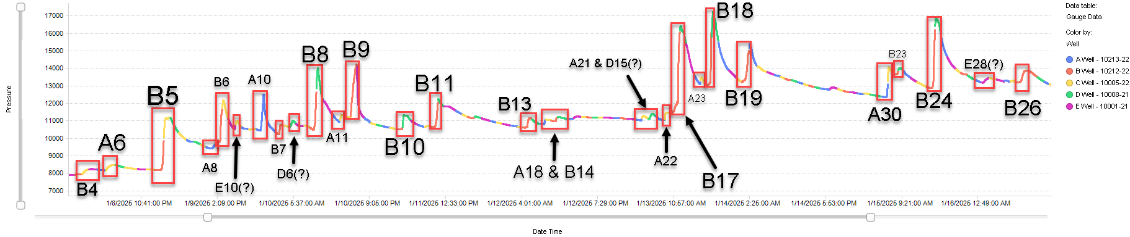
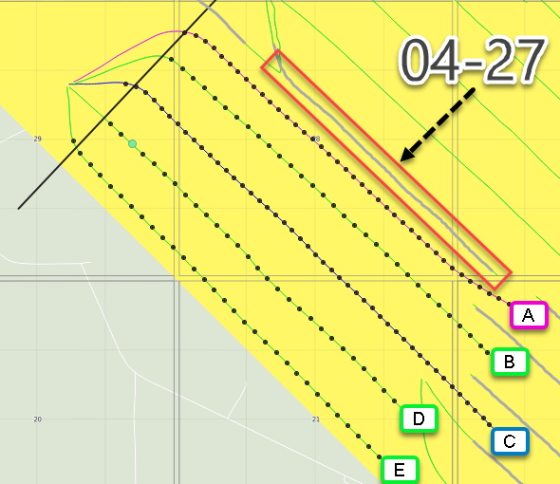
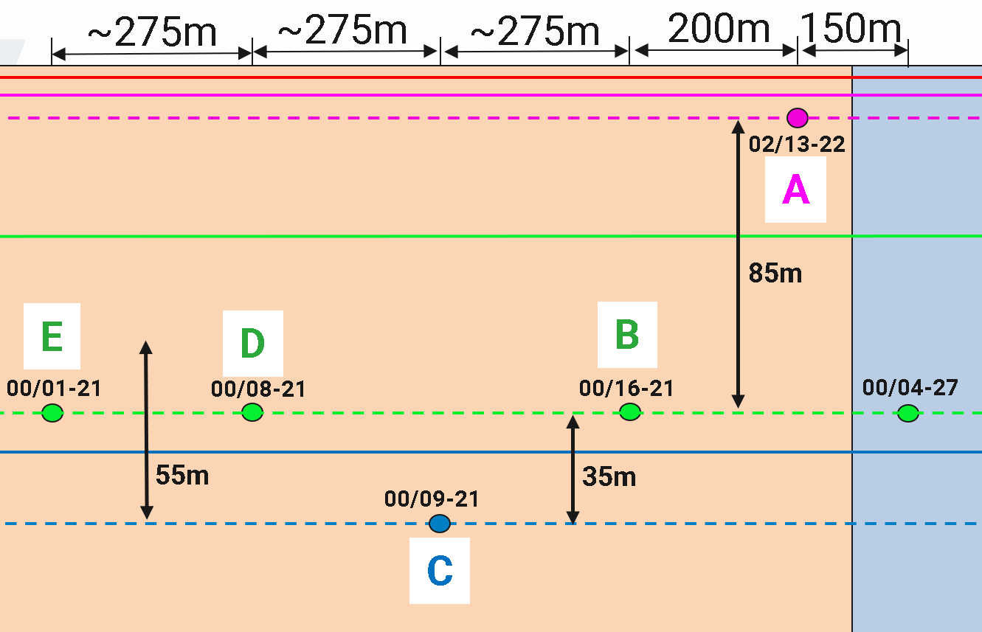
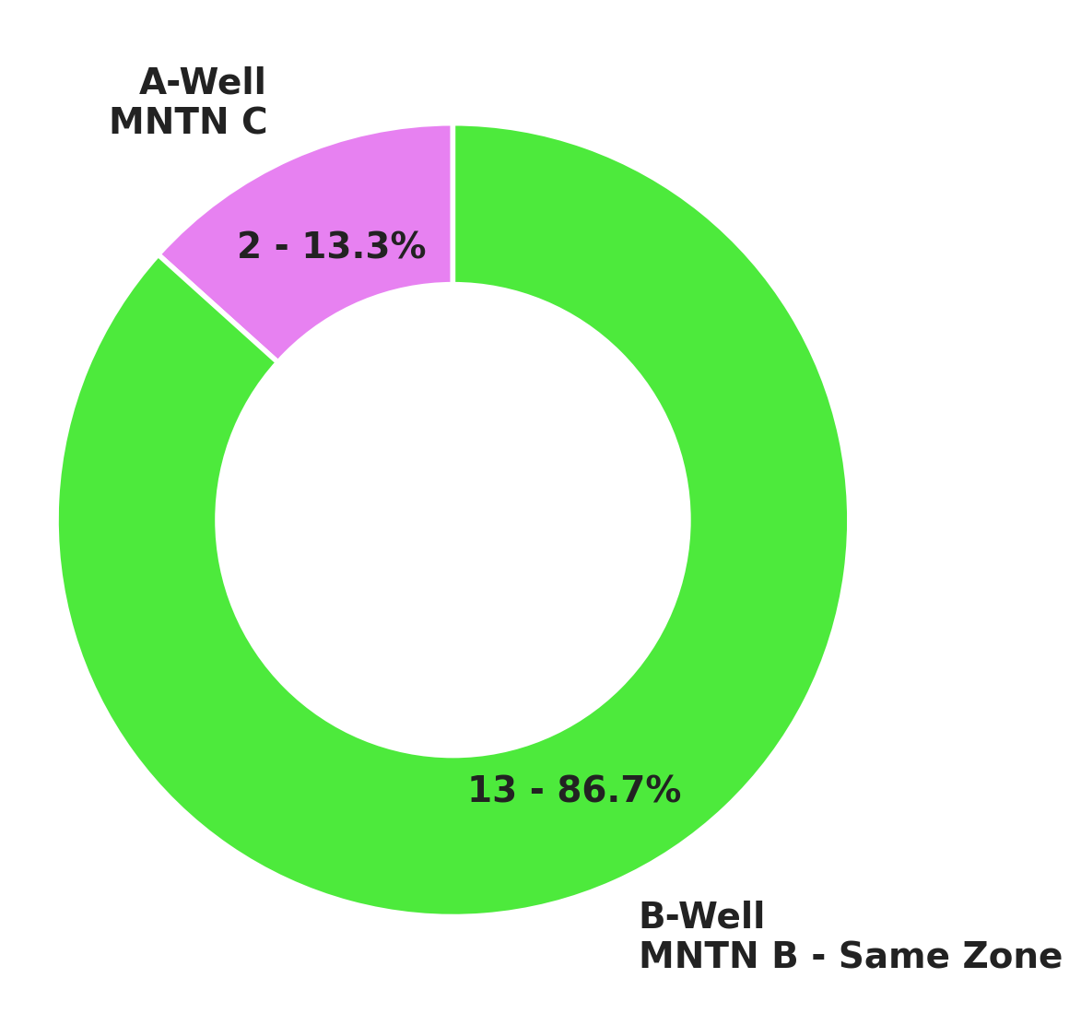
Frac Hit Analysis
Frac Spotfire Dashboard
Gauge data monitoring with the dashboard allows for easy identification of frac hits, both through auto-detection and easy visual flagging. Showcased on BIL 10-29 parent well, identifying that majority of sizeable hits occurred from the B-Well (same zone), rather than the child-well.
04-27 Gauge Data – Frac Hits Identified
Large Frac Hit Distribution
Conclusion: Identifying the pumping well with cleaned gauge data showcases the dashboard’s power to reveal reservoir dynamics, improve well-to-well communication insights, and optimize future zone selection. Helped inform 10-29 Phase 2 layout.

Slide 11
Additional Projects
Conclusion
Technical Data Analysis:
ExpressFiber Dashboard, 07-31 Clearvision, BIR Darkvision Completions, Seismic Array (PSN 16-33 & GC 14-30)
Operations Planning
Perforation Planning, Frac Design, Sequencing, Data Surveillance
Single-use Economic Analyses
L-Block, GORR, Individual Sections
Data Archiving
CGR Database, Legacy Flowback Model, Frac Gauge and Pumping Data
What’s Next
Back to school in September for last year of Software Engineering, graduation May 2026
Some Courses Include: Capstone (Team Design), Scalable Data Analytics, Quantum Theory/Computation
Work part-time during school with NuVista

